Slide 1



DAFNI Executive Board – 11/11/2020
Champion report
Juste Raimbault
CASA, UCL
Notes:
1

Slide 2
Current work
Interaction with platform development (issues/suggestions, data workshop)
OpenMOLE embedding: calibration of an urban network ABM (https://arxiv.org/abs/2009.05528)
New version of road network processing for MATSim: Functional Urban Areas networks
Microscopic distribution of SPENSER synthetic population
Minimal MATSim with uniform population (not yet on DAFNI)
Data: Global Human Settlement Layer (JRC-EC data); SPENSER UK synthetic populations (individuals and households) for 2020 provided by N. Lomax
Notes:
2

Slide 3
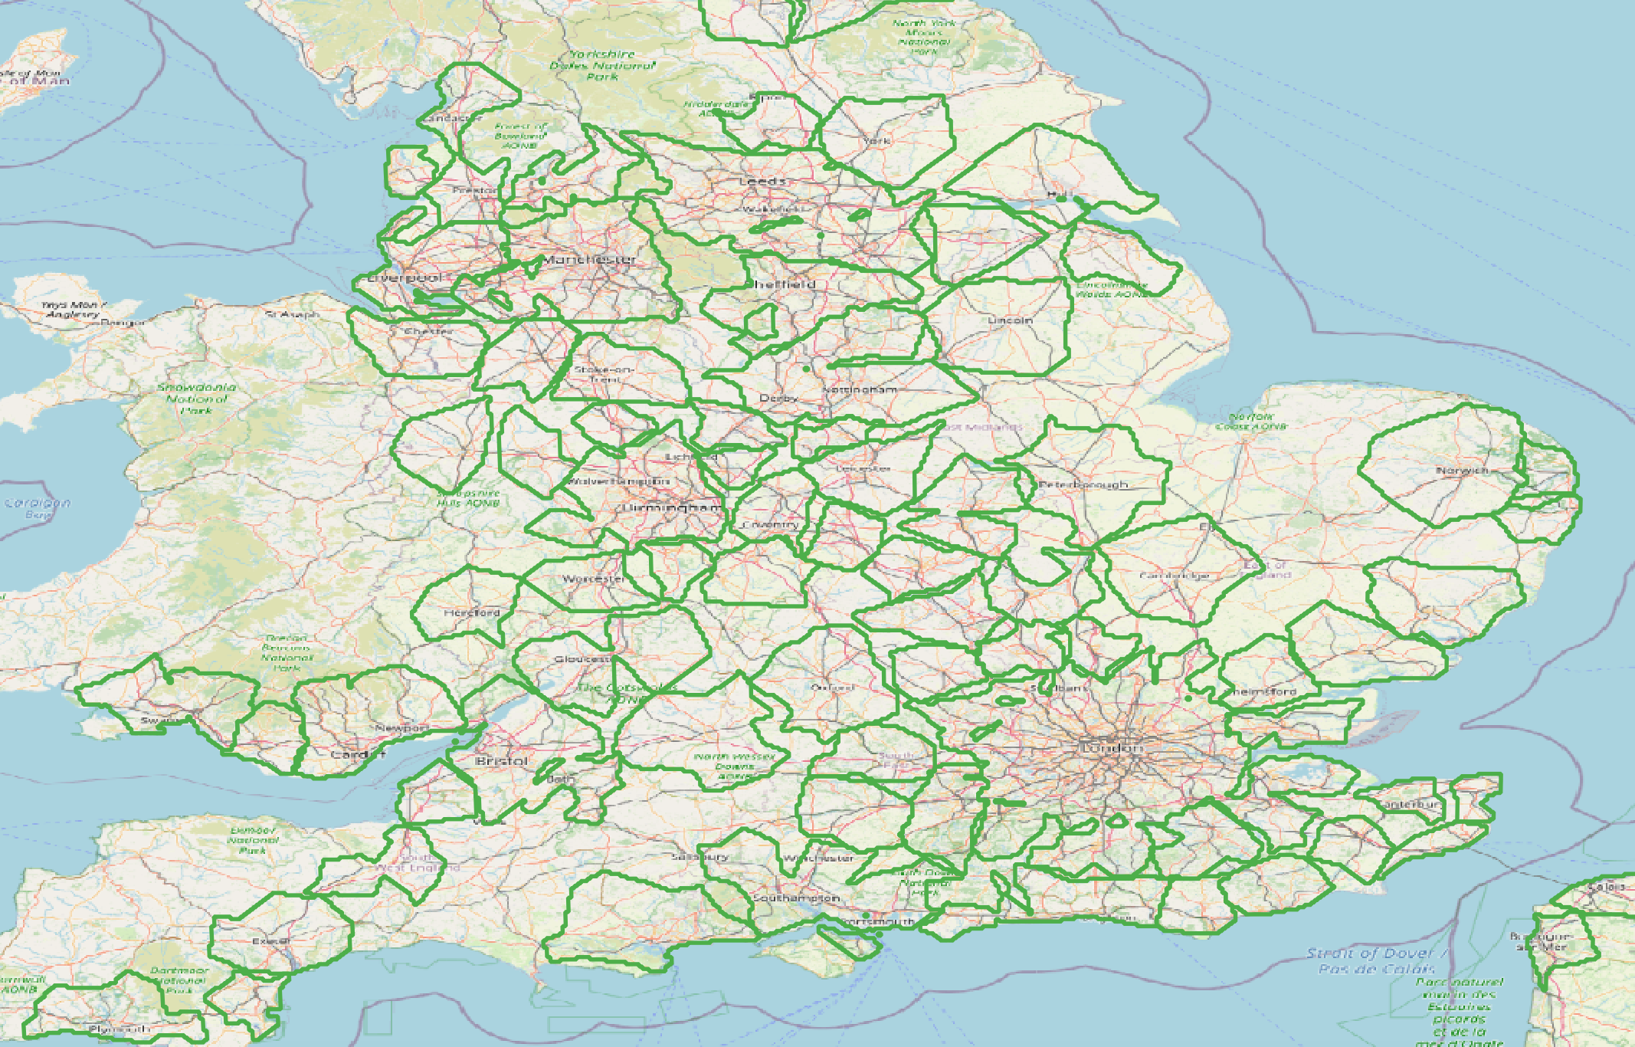
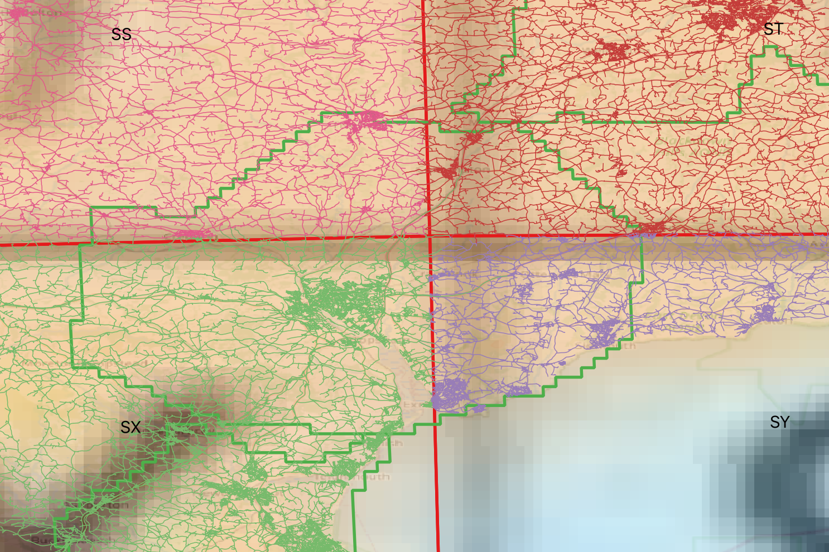
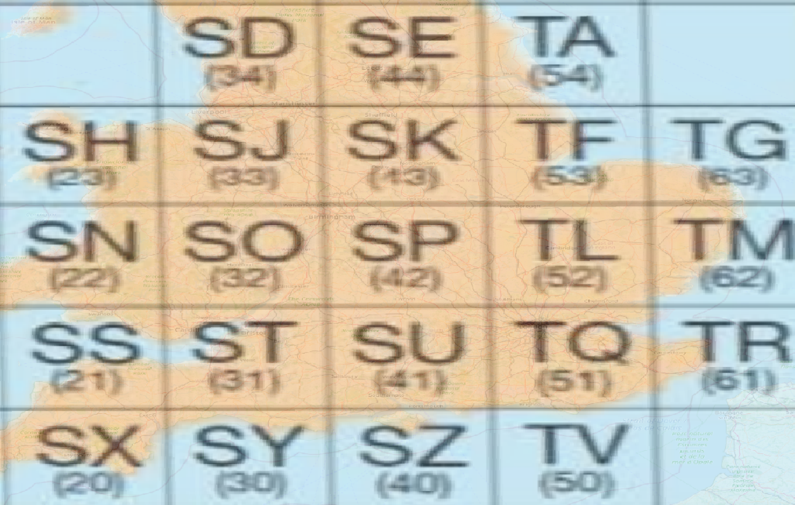
Road network preprocessing for MATSim on Functional Urban Areas
GHS FUAs
Construct topological network Export to MATSim xml
OS Roads tiles
Merge for queried FUA
-> Process all FUAs and publish processed networks under different formats?
Notes:
3

Slide 4
SPENSER synthetic population microscopic distribution
Synthetic individuals and households at the MSOA level in 2020
Distribute uniformly within the MSOA on network nodes; attribute jobs randomly within the FUAs given the MSOA employment distribution
“Four stage model”:
Distribute households within MSOAs according to population density grid (100m Eurostat or 1km GHSL) and buildings (OpenStreetMap) – individuals already matched in SPENSER data
Use QUANT calibrated parameters to estimate potential home-work flows
Sample workplace given these flows (Q: sample directly from data?), accessibility patterns and car ownership
Notes:
4

Slide 5
Next steps
Minimal MATSim model running on DAFNI (on processed network with a uniform population)
MATSim data processing: Multi-modal network construction, public transport timetables
MATSim outputs: first output processing model, prospective work for health indicators
Notes:
5

